Slide 1
Writing Kinect Programs
Using the Kinect Video Camera
Section 2.1

Slide 2
Topics
Adding the Kinect components to a Windows application
Creating a Kinect runtime instance
Configuring and starting the Kinect video camera
Building XNA textures from video data
Displaying error information in XNA programs

Slide 3
Using Kinect in a program
The Kinect sensor can be used in any kind of Windows PC program
XNA game
Windows Forms application
Windows Presentation Foundation (WPF) application
We are going to focus on the use of Kinect in XNA games on the Windows PC

Slide 4
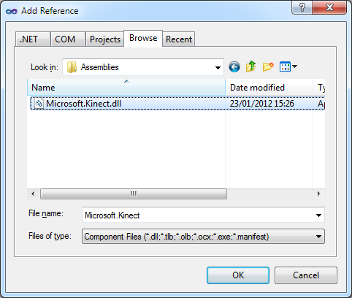
The Kinect for Windows SDK
The Kinect for Windows SDK is provided as a library of classes which must be added to the references in a project

Slide 5
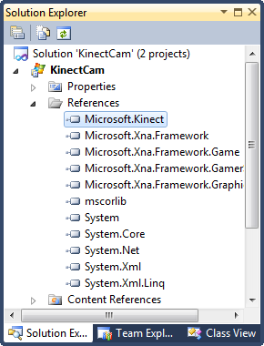
Adding the Kinect SDK reference
Once the reference has been added to the project it can be used by classes within it
Here you can see the references in an XNA project

Slide 6
The Kinect namespaces
using Microsoft.Kinect;
If you add the using statement to your program you can use the classes in the Kinect SDK directly
You can use fully formed names if you prefer to make your programs more explicit

Slide 7
The KinectSensor Class
KinectSensor myKinect;
The KinectSensor class provides a link between the application and the Kinect device
It works in the same way as a stream connects to a file or the XNA GraphicsDevice class provides access to the graphics hardware in a game

Slide 8
Getting a KinectSensor
// Get the first Kinect on the computer
myKinect = KinectSensor.KinectSensors[0];
The Kinect sensors connected to a computer are exposed as a static collection of KinectSensor instances
A single program can connect to multiple Kinect sensors
If there are no Kinect devices available this collection will be empty

Slide 9
Enabling the colour video stream
myKinect.ColorStream.Enable();
When a Kinect device is initialised the program selects the options it will be using
The ColorStream property exposes an instance of the ColorImageStream class
A program can call methods on this instance to configure the colour input stream
We are using the default configuration

Slide 10
Binding to Kinect Sensor Events
myKinect.ColorFrameReady += new EventHandler<ColorImageFrameReadyEventArgs> (myKinect_ColorFrameReady);
The camera, depth camera and skeleton tracking behaviours can generate events when they have new data
A program can bind handlers to these events in the same way as programs bind to other software events

Slide 11
Starting the Sensor
myKinect.Start();
This method starts the Kinect sensor running and starts using any of the streams that have been enabled
It is important to remember this call, otherwise you will spend a long time wondering why your sensor isn’t working..

Slide 12
Receiving sensor data
void myKinect_ColorFrameReady(object sender, ColorImageFrameReadyEventArgs e)
{ // this method will be called each time there
// is a new frame ready from the image sensor
}
The sensor will deliver a new video frame by calling this method
The method must make the image data available to the XNA game

Slide 13
XNA Textures and Video Data
Rectangle videoDisplayRectangle;
Texture2D kinectVideoTexture;
An XNA game uses the Texture2D type to hold an image to be drawn
It uses the Rectangle type to position the image on the screen
These two variables are used in the game to position and display the Kinect image

Slide 14
Creating the display rectangle
protected override void Initialize()
{
videoDisplayRectangle = new Rectangle(0, 0, GraphicsDevice.Viewport.Width, GraphicsDevice.Viewport.Height);
base.Initialize();
}
The Initialize method creates the display rectangle
It makes it the same size as the screen

Slide 15
Drawing the Texture
protected override void Draw(GameTime gameTime)
{
GraphicsDevice.Clear(Color.CornflowerBlue);
spriteBatch.Begin();
if (kinectVideoTexture != null)
spriteBatch.Draw(kinectVideoTexture, videoDisplayRectangle, Color.White);
spriteBatch.End();
base.Draw(gameTime);
}
The Draw method draws the texture if it exists

Slide 16
Creating Textures in Software
kinectVideoTexture = new Texture2D(GraphicsDevice, kinectVideoWidth, kinectVideoHeight);
...
Color[] bitmap = new Color[kinectVideoWidth * kinectVideoHeight];
...
kinectVideoTexture.SetData(bitmap);
A program can create an array of colour values which can then be used to define a texture

Slide 17
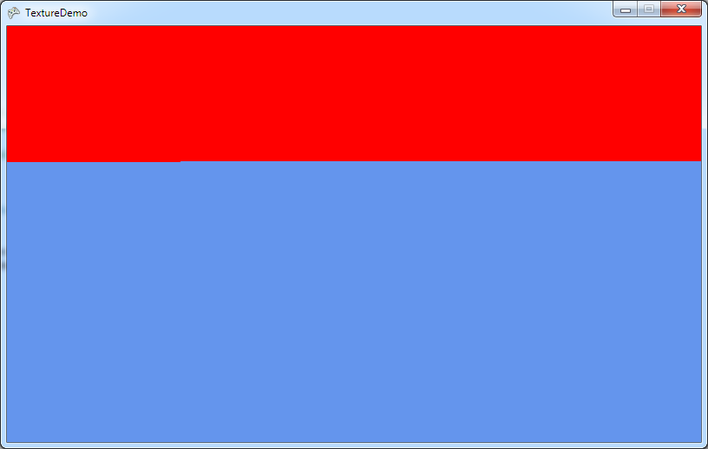
Demo
1 Creating textures from programs
Notes:
For this demonstration to work you must have installed the Kinect for Windows SDK. You must also have a Kinect sensor plugged into the USB Port on your computer.
Start Visual Studio 2010
Open the project TextureDemo in the 01 TextureDemo demo folder.
Run the program by pressing F5.
The program will start running and will display the video output on the screen. It will consist of a screen with a red top half.
Stop the program by selecting Debug>Stop Debugging
Open the source file TextureDemoGame.cs
Navigate to the method Update
Remind everyone that this is the XNA method is called to update the display.
Show that this method creates a new texture. It also contains a for loop that fills the first 100000 bytes of the bitmap array with red. The rest of the array is left holding an empty colour so that the blue background shows through.
Ask what would happen if the number was changed to 200000
Answer: There would be more red on the screen.
Change the number and run the program again.
Point out that the red part of image ends half way along a line.
Ask why this is.
Answer: Because the value 20000 does not take the program to the end of a line.
Explain that we are going to take a row of readings from the camera and use them to build a display.
Stop the program and exit Visual Studio.

Slide 18
The ColorFrameReady event
void myKinect_ColorFrameReady(object sender, ColorImageFrameReadyEventArgs e)
{ // this method will be called each time there
// is a new frame ready from the image sensor
}
When this method runs it must copy the video data from the camera into an XNA texture
This will then be displayed by the Draw method

Slide 19
The ColorFrameReady event
void myKinect_ColorFrameReady(object sender, ColorImageFrameReadyEventArgs e)
{ // this method will be called each time there
// is a new frame ready from the image sensor
}
The ColorImageFrameReadyEventArgs parameter e gives access to the image data
This is provided in a variable of type ColorImageFrame

Slide 20
The ColorFrameReady event
void myKinect_ColorFrameReady(object sender, ColorImageFrameReadyEventArgs e)
{ using (ColorImageFrame colorFrame = e.OpenColorImageFrame())
{ }
}
The OpenColorImageFrame method gets the colour frame from the parameter e
The frame contains the colour data

Slide 21
Enforcing garbage collection
void myKinect_ColorFrameReady(object sender, ColorImageFrameReadyEventArgs e)
{ using (ColorImageFrame colorFrame = e.OpenColorImageFrame())
{ }
}
The colorFrame value should be enclosed in a using block
This improves garbage collection

Slide 22
Garbage Collection and using
The using keyword allows a program to explicitly state where in a program a particular resource is being used
When the program exists the block following the using keyword the resource created at that point can be removed
This is particularly important in the Kinect application as it will be generating large frames of data many times a second

Slide 23
Null image frames
void myKinect_ColorFrameReady(object sender, ColorImageFrameReadyEventArgs e)
{ using (ColorImageFrame colorFrame = e.OpenColorImageFrame())
{
if (colorFrame == null) return;
}
}
If the frame is null we must not try to use it
This occurs if the event hander runs late

Slide 24
Storing colour data
byte[] colorData = null;
...
if (colorData == null)
colorData = new byte[colorFrame.Width * colorFrame.Height * 4];
The colour data from the camera is supplied as four data bytes per pixel
Blue, Green and Red intensity followed by the transparency (alpha) value
The larger the value the brighter that colour

Slide 25
Storing colour data
byte[] colorData = null;
...
if (colorData == null)
colorData = new byte[colorFrame.Width * colorFrame.Height * 4];
The above statements declare a buffer array called colorData
The first time it is used it is created with the required size, obtained from the colorFrame dimensions

Slide 26
Copying colour data from the frame into the buffer
colorFrame.CopyPixelDataTo(colorData);
The CopyPixelData method gets the colour information out of the frame and places it in the colorData array
The program will use this information to create the XNA texture to be drawn

Slide 27
Story so far..
The program now has the colour data bytes from the camera image
four bytes per pixel giving the colour of each and the transparency
It could do some image processing on these data bytes at this point
However, to start with we are just going to take the values and make a texture for display by the game

Slide 28
Creating the colour values
Color[] bitmap = new Color[colorFrame.Width * colorFrame.Height];
The video texture will be created from an array of Color values
This statement creates an array of Color values of the appropriate size
Next the program must set the colour of each location to the colour supplied by the camera for that point

Slide 29
Building the colour image
int sourceOffset = 0;
for (int i = 0; i < bitmap.Length; i++)
{
bitmap[i] = new Color(colorData[sourceOffset + 2], colorData[sourceOffset + 1], colorData[sourceOffset], 255);
sourceOffset += 4;
}
This code creates a Color value for each pixel in the video image

Slide 30
Building the colour image
int sourceOffset = 0;
for (int i = 0; i < bitmap.Length; i++)
{
bitmap[i] = new Color(colorData[sourceOffset + 2], colorData[sourceOffset + 1], colorData[sourceOffset], 255);
sourceOffset += 4;
}
Start at the beginning of the colour data received from the camera

Slide 31
Building the colour image
int sourceOffset = 0;
for (int i = 0; i < bitmap.Length; i++)
{
bitmap[i] = new Color(colorData[sourceOffset + 2], colorData[sourceOffset + 1], colorData[sourceOffset], 255);
sourceOffset += 4;
}
Work through all the colour values in the bitmap

Slide 32
Building the colour image
int sourceOffset = 0;
for (int i = 0; i < bitmap.Length; i++)
{
bitmap[i] = new Color(colorData[sourceOffset + 2], colorData[sourceOffset + 1], colorData[sourceOffset], 255);
sourceOffset += 4;
}
Create a new colour value and put it in the colour bitmap

Slide 33
Creating a Color value
bitmap[i] = new Color(colorData[sourceOffset + 2], colorData [sourceOffset + 1], colorData [sourceOffset], 255);
A new Color instance is created using the appropriate parts of the colourData array
The sourceOffset variable gives the current position in the array
The alpha value is set to 255, which is not transparent at all

Slide 34
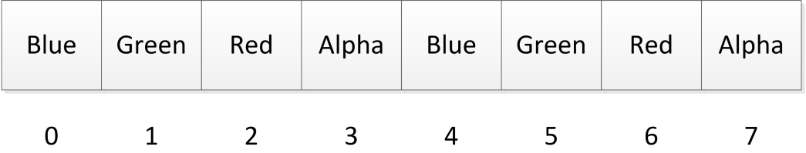
colorData array format
This format is called BGRA
Each pixel is given as four bytes in order
Blue intensity
Green intensity
Red intensity
Alpha value – the transparency of the pixel

Slide 35
Building the colour image
int sourceOffset = 0;
for (int i = 0; i < bitmap.Length; i++)
{
bitmap[i] = new Color(colorData[sourceOffset + 2], colorData[sourceOffset + 1], colorData[sourceOffset], 255);
sourceOffset += 4;
}
The order of the bytes in the data array is Blue, Green, Red, so the offsets must reflect this

Slide 36
Building the colour image
int sourceOffset = 0;
for (int i = 0; i < bitmap.Length; i++)
{
bitmap[i] = new Color(colorData[sourceOffset + 2], colorData[sourceOffset + 1], colorData[sourceOffset], 255);
sourceOffset += 4;
}
This moves down the video array to the set of four bytes describing the next pixel

Slide 37
Moving down the colorData array
sourceOffset += 4;
The sourceOffset variable holds the position in the colorData array
After each pixel has been created it is moved on to the next one in the source
This is four pixels down from the previous one

Slide 38
The Image Building loop
int sourceOffset = 0;
for (int i = 0; i < bitmap.Length; i++)
{
bitmap[i] = new Color(image.Bits[sourceOffset + 2], image.Bits[sourceOffset + 1], image.Bits[sourceOffset], 255);
sourceOffset += 4;
}
Start at the beginning of the source array

Slide 39
The Image Building loop
int sourceOffset = 0;
for (int i = 0; i < bitmap.Length; i++)
{
bitmap[i] = new Color(image.Bits[sourceOffset + 2], image.Bits[sourceOffset + 1], image.Bits[sourceOffset], 255);
sourceOffset += 4;
}
Loop through the colour values in the bitmap

Slide 40
The Image Building loop
int sourceOffset = 0;
for (int i = 0; i < bitmap.Length; i++)
{
bitmap[i] = new Color(image.Bits[sourceOffset + 2], image.Bits[sourceOffset + 1], image.Bits[sourceOffset], 255);
sourceOffset += 4;
}
Make a new color and store it in the bitmap

Slide 41
The Image Building loop
int sourceOffset = 0;
for (int i = 0; i < bitmap.Length; i++)
{
bitmap[i] = new Color(image.Bits[sourceOffset + 2], image.Bits[sourceOffset + 1], image.Bits[sourceOffset], 255);
sourceOffset += 4;
}
Move on to the next set of BGRA format data

Slide 42
Creating the texture
kinectVideoTexture = new Texture2D(GraphicsDevice, colorFrame.Width, colorFrame.Height);
kinectVideoTexture.SetData(bitmap);
Once the program has loaded the new Color data into the bitmap array it just has to create an XNA texture and set this to the data as shown above

Slide 43
Adjusting the camera angle
myKinect. ElevationAngle += 5;
The Kinect sensor bar contains a motor that adjusts the vertical angle of the sensor
A program can control this motor adjust the elevation angle of the sensor and give it the best view of the scene
It can do this by adjusting the ElevationAngle as shown above

Slide 44
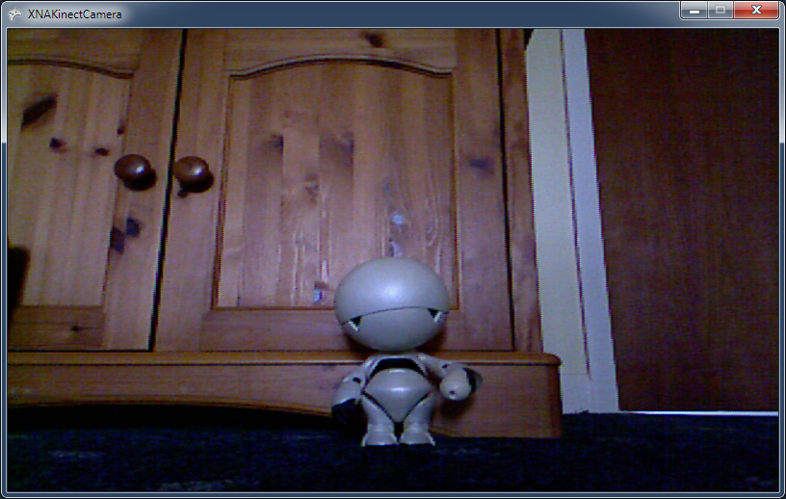
Demo
2 Kinect video output
Notes:
For this demonstration to work you must have installed the Kinect for Windows SDK. You must also have a Kinect sensor plugged into the USB Port on your computer.
Start Visual Studio 2010
Open the project KinectCam in the 02 Camera Capture Demo demo folder.
Run the program by pressing F5.
The program will start running and will display the video output on the screen.
Stop the program by selecting Debug>Stop Debugging
Open the source file KinectCameraGame.cs
Navigate to the method myKinect_VideoFrameReady
Show that this code does the video conversion of the frames.
Find the statement for (int i = 0; i < bitmap.Length; i++)
Ask what would happen if you changed the length value to bitmap.Length/2
Answer: Only the top half of the screen would be displayed
Make the change and show that this is what happens.
Now find the statement
bitmap[i] = new Color(image.Bits[sourceOffset + 2], image.Bits[sourceOffset + 1], image.Bits[sourceOffset], 255);
Ask what would happen if the +2 and the +1 elements were swapped
Answer: The blue and the green color colours would be swapped over
Make the change and show that this is what happens
Put the values back again and show the program working properly.
Press U to show that the camera looks up.
Press D to show that the camera looks down.
Stop the demo and leave Visual Studio.

Slide 45
Kinect and Errors
myKinect.ColorStream.Enable();
At the moment the program has no error handling built in
If the above call of Enable fails the program will just crash
This is not acceptable
It should not be possible to make the program fail by unplugging the sensor bar

Slide 46
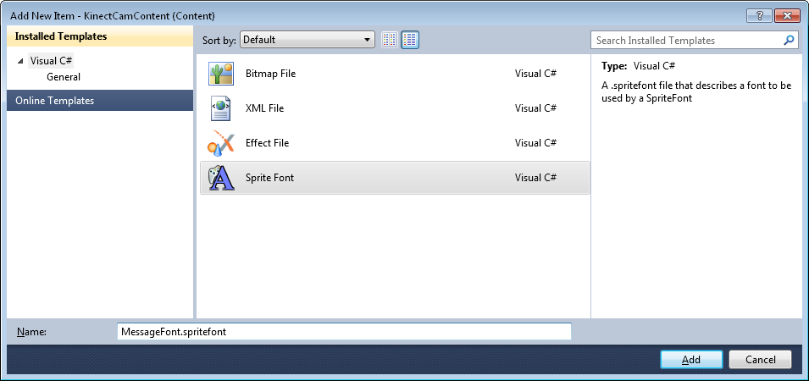
Displaying Messages
XNA programs cannot draw text directly
A game must create a SpriteFont asset and use this to draw text

Slide 47
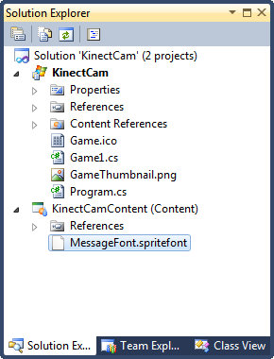
The SpriteFont resource
Once the SpriteFont has been added to the XNA Content project it can be used in a game to draw text
We are going to use it to display error messages

Slide 48
Loading the SpriteFont
SpriteFont messageFont;
protected override void LoadContent()
{
// Create a new SpriteBatch, used to draw textures.
spriteBatch = new SpriteBatch(GraphicsDevice);
messageFont = Content.Load<SpriteFont>("MessageFont");
}
The LoadContent method loads the font into the program

Slide 49
Drawing Messages
string errorMessage = "";
protected override void Draw(GameTime gameTime)
{
GraphicsDevice.Clear(Color.CornflowerBlue);
spriteBatch.Begin();
if (errorMessage.Length > 0) spriteBatch.DrawString(messageFont, errorMessage, Vector2.Zero, Color.White);
spriteBatch.End();
base.Draw(gameTime);
}
The Draw method displays any error message

Slide 50
Handling Kinect errors
protected bool setupKinect()
{
if (KinectSensor.KinectSensors.Count == 0)
{
errorMessage = "No Kinects detected";
return false;
} // Rest of Kinect setup here
}
We can create a Kinect setup method that displays errors where appropriate

Slide 51
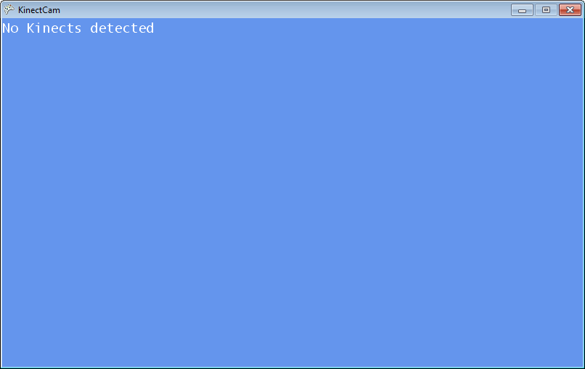
Demo
3 Kinect Error Detection
Notes:
For this demonstration to work you must have installed the Kinect for Windows SDK. You must also have a Kinect sensor plugged into the USB Port on your computer.
Start Visual Studio 2010
Open the project XNAKinectCamera in the 03 Kinect Errors demo folder.
Run the program by pressing F5.
The program will start running and will display the video output on the screen.
Stop the program by selecting Debug>Stop Debugging
Unplug the Kinect sensor
Run the program again
Note that it now displays a sensible error message
Stop the program and exit Visual Studio.

Slide 52
Summary
The Kinect SDK is added as a library assembly to the references for a program
The Kinectclass provides access to sensor features
The Kinect video camera can generate events when a new video image is ready for processing
An XNA program can convert the image information received from the camera into colour information for display on an XNA texture
Programs can use XNA SpriteFonts to display error messages to user

